Slide 1

AI & Digital First transformations services
for global enterprises

Slide 2
What is Pulse Platform?
NETCON PULSE is an innovative, all-in-one IT management platform developed by Netcon to address the complexities of multi-cloud environments. It provides a unified interface for managing, monitoring, and optimizing cloud resources across various providers such as AWS, Azure, Google Cloud, and private clouds, network environments.
NETCON PULSE will focus on 4 IT management pillar & tasks primarily
Monitoring & Observability
Security & Financial Governance
Application & Infrastructure Deployment and release management
IT Operations & SLA, Service management / Dashboards

Slide 3
Why Pulse Portal?
Pulse includes multiple cloud services from different providers to avoid vendor lock-in, enhance flexibility, and optimize costs. This approach allows organizations to leverage the best features of each cloud provider. Pulse tools are versatile and can be adapted for various industrial applications.
Key benefits:
Centralized management of IT processes.
Custom integration
Productivity ,single point of access reducing the manual effort spent in accessing multiple platforms.
Cost effective ,ability to adapt and reuse existing infrastructure and applications.
Customizable dashboards to project data that is both predictive and real time data regarding cloud and application spending, AMI, MTTA and MTTR, business expense etc.

Slide 4
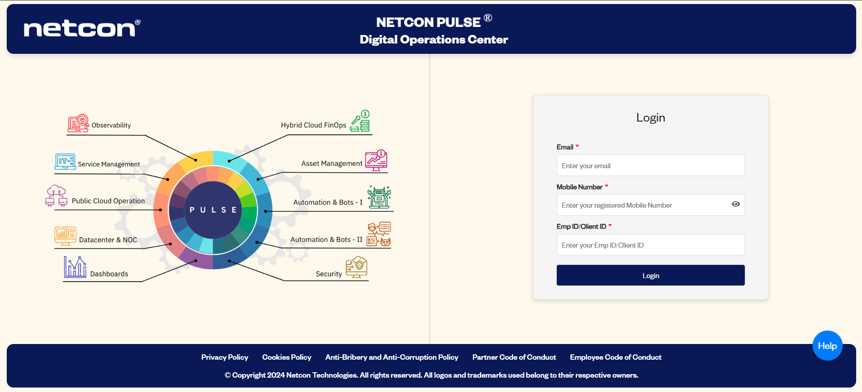
Pulse Platform Login Page

Slide 5
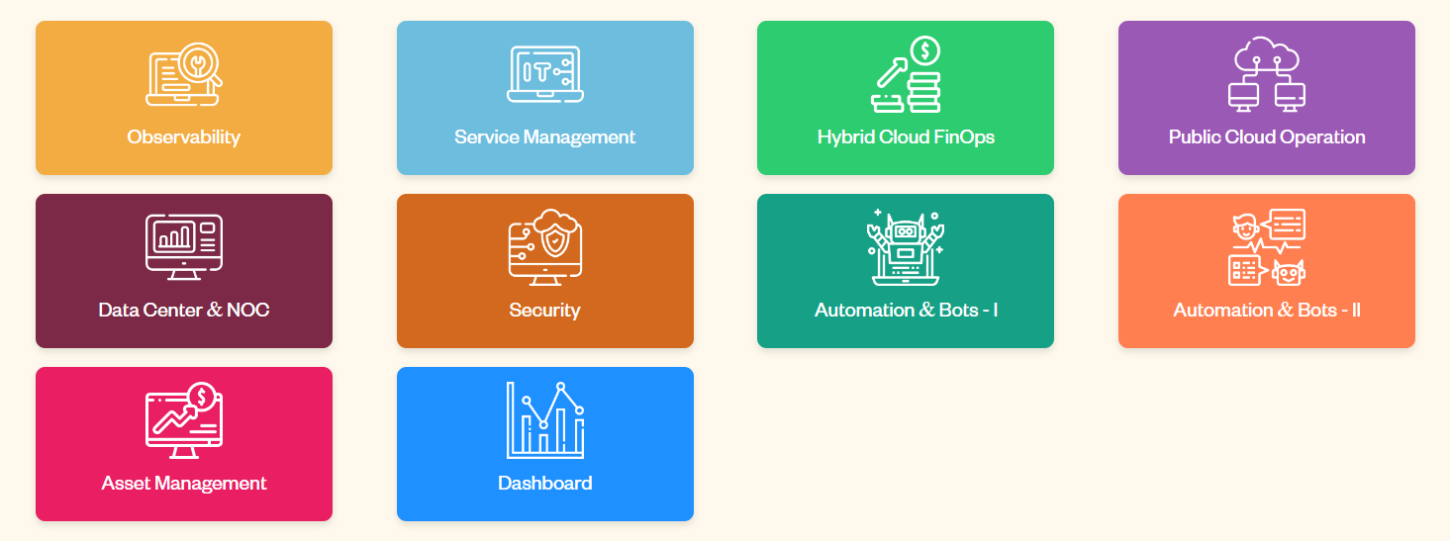
Services Offered Under Pulse

Slide 6
Security, Auditing & continuous availability guidelines followed
Authentication
SSO enabled
MFA enabled
OTP Expiry in 60secs
Pulse page expiry in 30mins
Access Control
Role based Portal Access
Pulse Portal access enabled for Desktop, Mobile & Tablet view
Support
Help button - enables user to submit query with Pulse portal Admin
Auditing
DB integration to fetch Portal traffic report, Services consumed, top issues reported etc.
Pulse Portal Logs
CI/CD Pipelining
Continuous Front-end & Back-end Code Update via GitHub

Slide 7
Observability
Observability as a Service in Pulse Platform helps implement a robust IT Operations Management solution that can provide real-time monitoring, automated incident response, and comprehensive visibility into the IT environment. This solution helps streamline IT operations, reduce downtime, and improve overall efficiency.

Slide 8

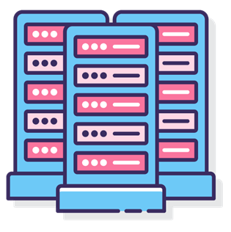

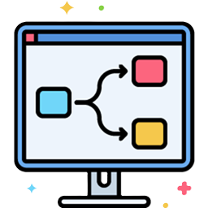

Observability
DASHBOARD
INVENTORY MANAGEMENT
ALARM CONFIGURATION
WORKFLOWS
REPORTS

Slide 9



Service Management
Service management: Service management in Pulse, involves the implementation and management of quality IT services it comes with integration capabilities to connect with monitoring, automation and dashboard for enhanced efficiency, improved productivity and analytical insight.
EFFICIENCY
HIGH PRODUCTIVITY
ANALYTICAL INSIGHTS

Slide 10

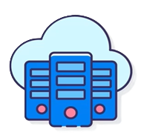


Hybrid FinOps
Hybrid cloud finops is the application of finops principles across public and private cloud environments and on-premises infrastructure to manage multiple cloud resources, achieve greater flexibility and cost efficiency. Hybrid cloud finops service in Pulse platform is managed using Corent ComPaaS.
EFFICIENCY
GOVERNANCE AND COMPLIANCE
SEAMLESS MANAGEMENT
MULTI CLOUD MANAGEMENT
COST ALLOCATION

Slide 11

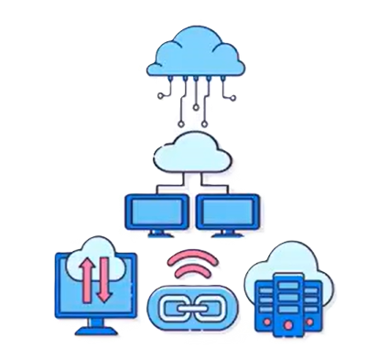



Public Cloud Operation
Public Cloud Operation is the management and maintenance of cloud computing services on Pulse Platform providing computing power, storage, and networking resources that are shared among multiple users.
CLOUD INTEGRATION
SCALABILITY
COMPREHENSIVE SECURITY
IDENTITY MANAGEMENT
PROJECT MANAGEMENT

Slide 12
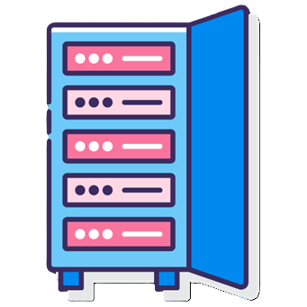


Data Center and NOC
Data center operations, Involve managing and maintaining infrastructure and services within a data center to ensure optimal performance, reliability, and security.
Network operations center involves management of monitoring and maintaining a network by IT professionals using a centralized tool. NOC acts as the control room for the data center, overseeing network operations, detecting issues, and ensuring seamless network performance.
DATA CENTER
NETWORK OPERATIONS
DETECTING ISSUES

Slide 13

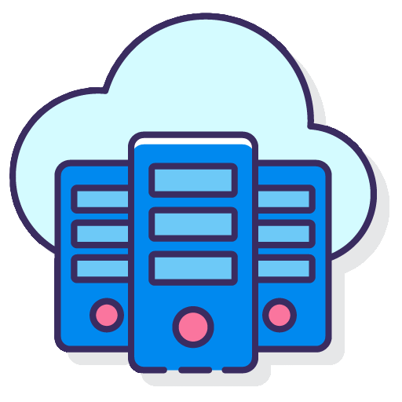

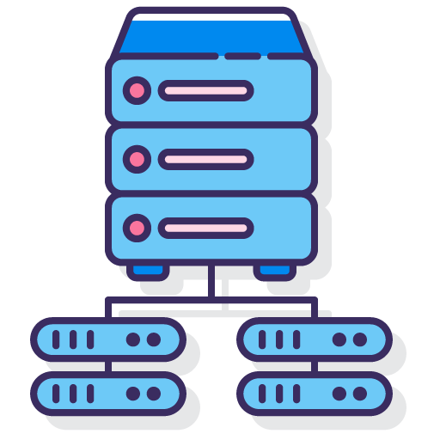
Security
Security is a service of pulse platform designed to provide comprehensive protection for the environments. It also offers Natural Language Investigation, Frictionless deployment, continuous runtime threat enrichment and cost efficiency by integrating various security functions, helping detect, investigate, and remediate security issues quickly and efficiently
IDENTITY
INFRASTRUCTURE
VULNERABILITIES
WORKLOADS

Slide 14
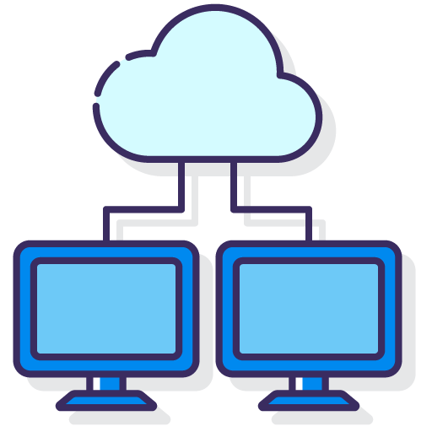

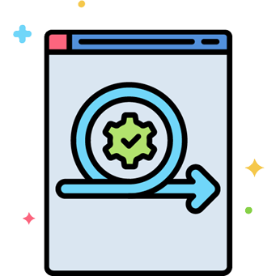
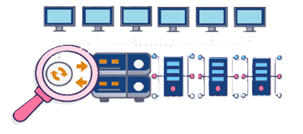
Automation
IT automation refers to the use of software and systems to create repeatable instructions and processes to replace or reduce human interaction with IT system.
SERVER PROVISIONING
APPLICATION DEPLOYMENT
CONFIGURATION MANAGEMENT
SYSTEM MONITORING

Slide 15
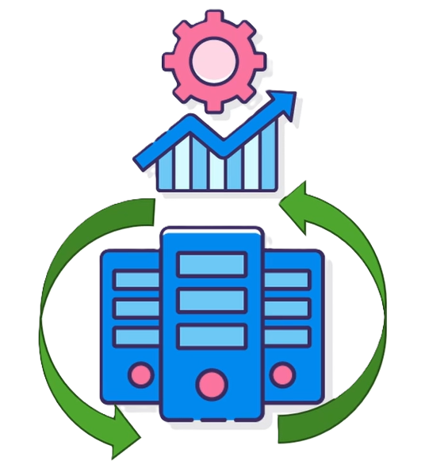
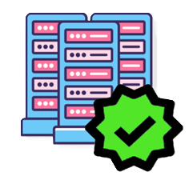

Asset management
IT Asset Management in Pulse Platform is a set of practices and tools used to manage and optimize the lifecycle of IT assets within an organization. It offers robust IT Asset Management solution that helps organizations efficiently manage their IT assets.
INVENTORY DISCOVERY
CENTRALISED
DATABASE
ASSET LIFECYCLE MANAGEMENT
COMPLIANCE AND RISK MANAGEMENT

Slide 16



Automation Bots II
Automation Bots in pulse is a store front, which includes end to end tested and functional bots. Bots are specifically designed for IT processes, it can significantly enhance efficiency and accuracy by automating repetitive and time-consuming tasks. The Bots cover the following categories: System and network bots, Enterprise applications bots and Custom applications bots. Overall, the Bot Store has over 100 Bots for on-demand consumption, it can be customized to fit existing technology stack and estate of a customer.
EFFICIENCY
ACCURACY
REPEATATIVE TASKS

Slide 17



Dashboard
Dashboard, a service offered by Pulse is used for data analytics and visualization. This Service offers various standardized reports which includes reports on ITSM ,Automation maturity and penetration, expenses ,travel, app and website traffic report. Reports can be further customized as per the growing needs.
AMI REPORT
BUSSINESS EXPENSE
ITSM REPORT

Slide 18
Technology Stack
Services | Tools | Hosted On | Owner
Observability | Zoho OpManager | On-Prem | Arun & Team
Service Management | Zoho MESDP | On-Prem | Arun & Team
Hybrid Cloud FinOps | Compaas | Vendor Environment | Rohit & Team
Public Cloud Operations | Azure | Azure | Arun & Team
Data Center and NOC | Zoho MESDP | On-Prem | Arun & Team
Security | Ariksa | Vendor Environment | Rohit & Team
Automation Bots I | RedHat AAP | Azure | Rohit & Team
Automation Bots II | Scripts | Azure | Rohit & Team
Asset Management | Euladox | On-Prem (ControlS VM) | Rohit & Team
Dashboard | Power BI | Azure | Rohit & Team

Slide 19
Supporting Technology
Technology | Tools | Hosted On | Owner
Database | MySQL | Azure | Rohit & team
Active Directory | Azure AD | Azure | Arun & Team
SSO | Azure | Azure | Arun & Team
SMTP Server | Send mail message Module | On-Prem | Arun & Team
PowerShell | PowerShell IDE | Azure | Rohit & Team
Python | Python Idle | Azure | Rohit & Team
React Js(NodeJs) | VS Code | Azure | Rohit & Team
GitHub | GitLab | Azure | Rohit & Team
SonarQube | Sonar Scanner | Azure | Rohit & Team

Slide 20
Thank You

